Slide 1






Madhya Pradesh Jal Nigam
Jal Rekha
28th January 2026

Slide 2

Digital Project Monitoring Initiatives
For MP Jal Nigam By MPSeDC
Jal Rekha
Low cost Make in India Initiative
Agenda

Slide 3
Digital Project Management - Jal Rekha
“Jal Rekha” is a GIS based tool which can be easily accessible via android & web application to monitor and management of the progress in MVS (Multi Village Water Supply Schemes) under JJM in Madhya Pradesh.
Precise Asset Tracking : Real time location tracking of assets installed and parallel visual comparison with approved designs.
Ingenious Quality Assurance: Reduce time consumption in inspection procedures and improved work quality through categorized inspections.
Advance Decision Making : Weekly publishing of progress in workplan, inspection and water supply details enables the “Jal Rekha” team to take precise decisions in time.
Partnering Up : Partnering the geographically referenced design & drawing data sets with other departments like Urban, Road, Telecom, MPEB, Domestic Gas Supply agencies etc enables them to receive NOC from respective departments and to execute their plan in time with out creating any fuss.

Slide 4
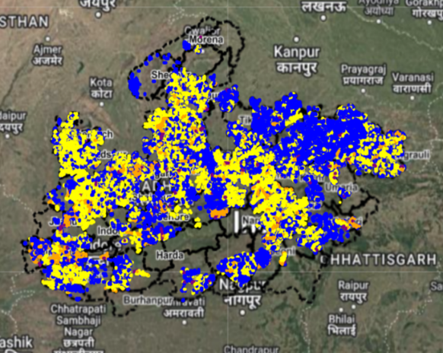
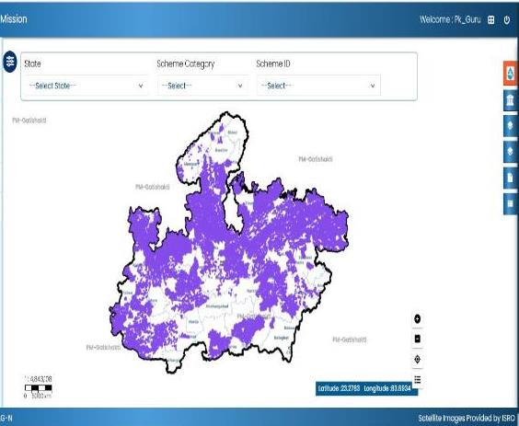
Digital Project Management - Jal Rekha
Information about the MVS assets (Intake Well, WTP, OHT & Supply lines) constructed over the ground are geo-tagged in Jal Rekha application and uploaded on Jal Rekha Portal. These GIS based layers were also successfully uploaded over the PM- Gati Shakti portal through an API.

Slide 5
Digital Project Monitoring Initiatives – Modules Developed
1. Execution
Jal Rekha
Asset Mapping (OHTs, Intake etc)
2. O&M
Dhara (Water Quantity)
Panchayat Darpan
3. Personnel
(HR Mgmt.)
ePrabandhan
Anushravan (RFIs)
ePraman (eMB)
4. General
Jal Samagra
Jal Rekha
Nirmal (Water Quality)
Bulk Water Charges from GPs
Water User Charges from Citizens
SARTHAK
E-Office
Sahbhagita (ISAs)
Sopan
Jal Samadhan
Bharosa
O&M Billing (GM & Contractor Modules)
FHTC

Slide 6
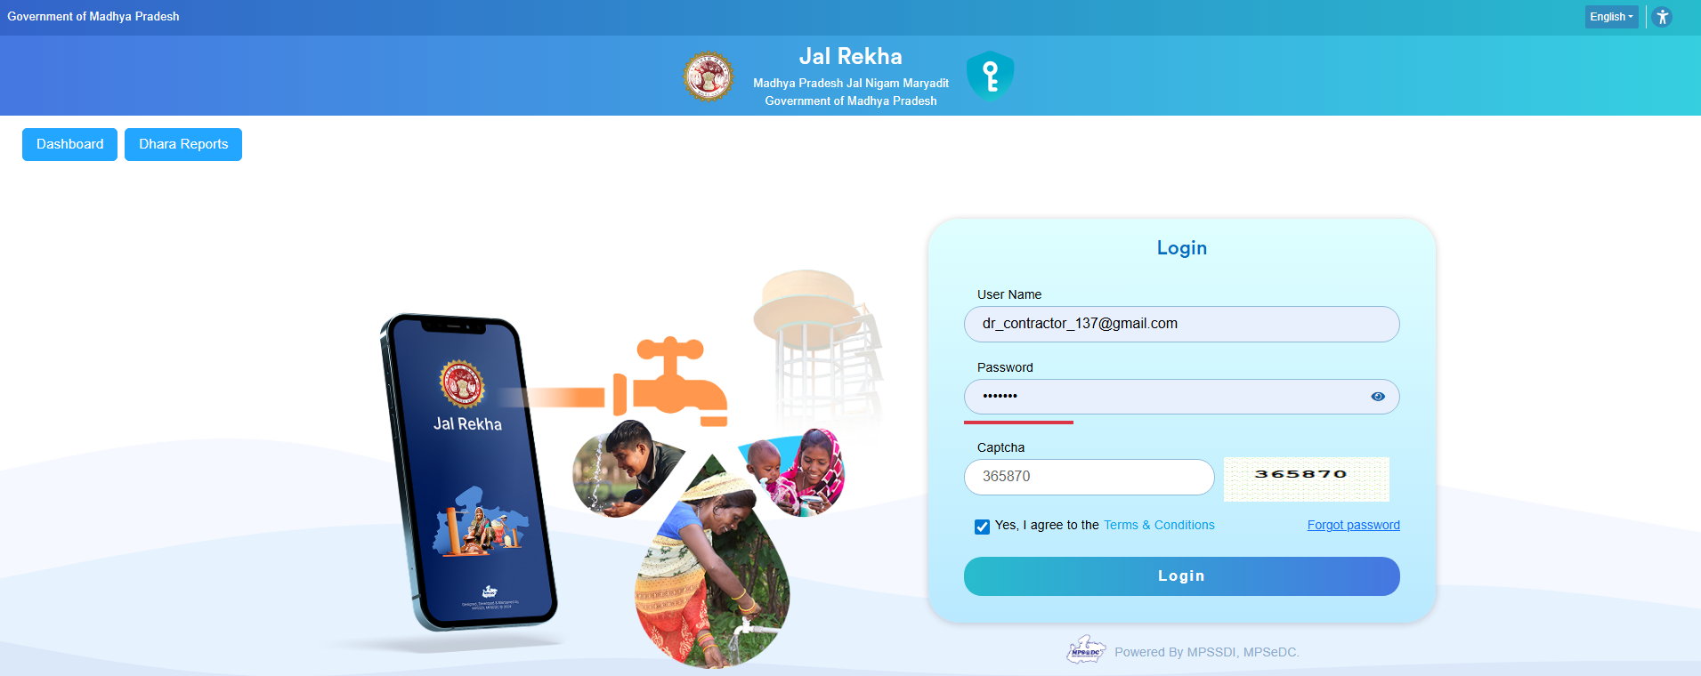
O&M Billing (GIS-based Operation and Maintenance Modules)
Introduction
The O&M Billing module in Jal Rekha manages end‑to‑end payment processing for operation and maintenance of schemes, from data capture by GM/contractor to multi‑level approval and final bill generation.
Purpose and scope
Supports preparation of O&M bills for each scheme, covering advances, manpower, CPI‑linked financial calculations, deductions and net payable amount.​
Pulls technical inputs from Dhara (water‑supply/meter readings) and Nirmal (water‑quality) so billing reflects actual performance against SLBM norms and penalties.

Slide 7
O&M Billing (GIS-based Operation and Maintenance Modules)
Core functionality
GM O&M creates scheme‑wise billing cases, uploads supporting documents, and assigns the scheme to a contractor for bill preparation.​
Contractor pages cover manpower, residual‑pressure service points, RM village mapping and management norms; the system computes gross bill, deductions and net payable bill.​
Data from Dhara water‑supply entries automatically feeds into O&M billing so consumption, service level and UFW‑related penalties are reflected.
Key actors and roles
GM O&M logs in, fills basic and advance‑form details, updates scheme status and performs primary financial calculations for billing.​
Contractor enters their details, fills CPI‑based financial calculations, maps bulk users and deductions, and generates the draft bill.​
PIU GM/SQC/PMC/Deputy Manager/Head office (CGM, PD, CFO, CA, MD) review, edit, comment and approve bills in sequence until final sanction

Slide 8
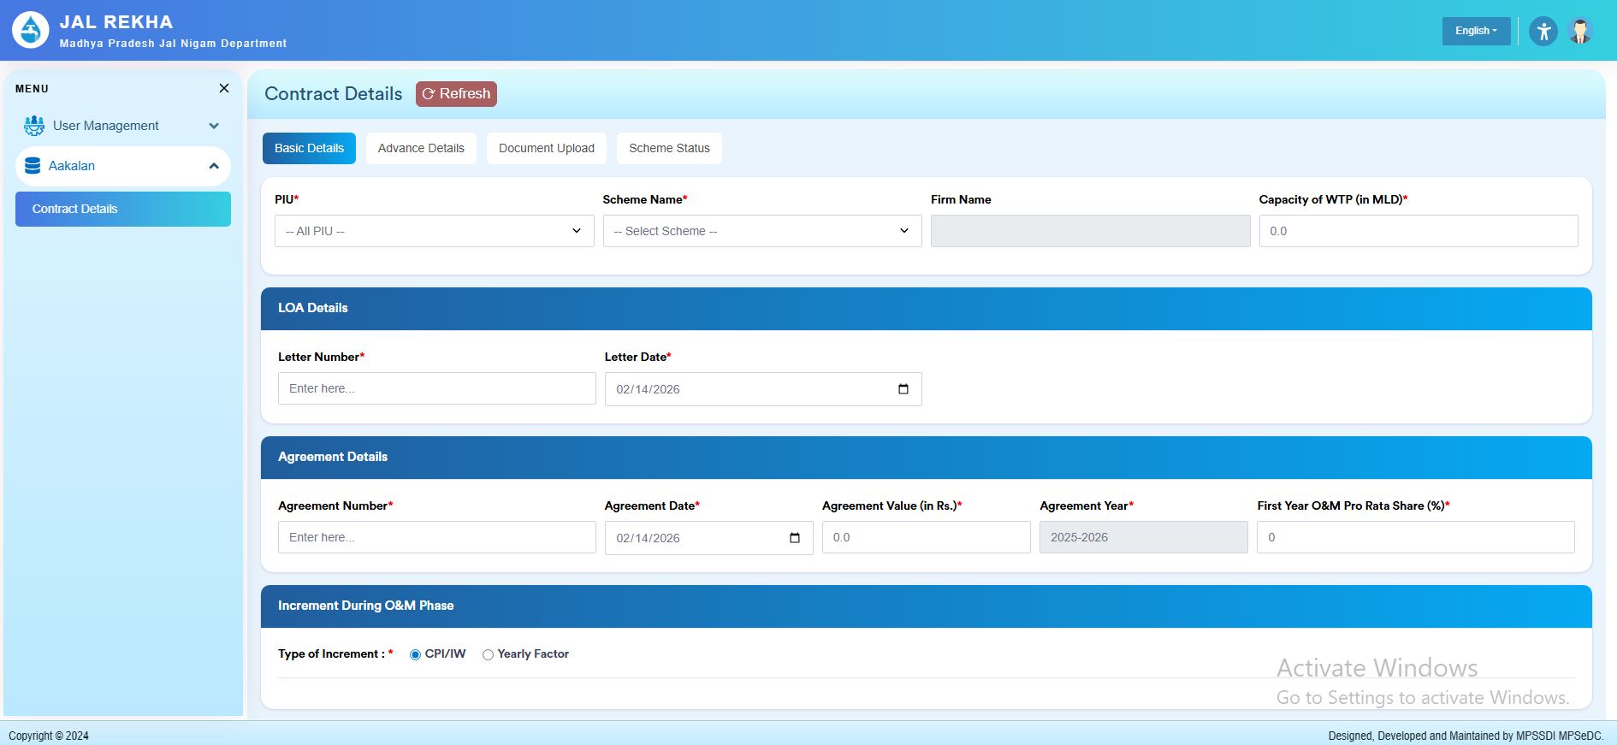
O&M Billing (GIS-based Operation and Maintenance Modules)
O&M Billing – GM Login
GM O&M Billing login covers Basic Contract Details, Advance Details, Document Upload, and Scheme Status.

Slide 9
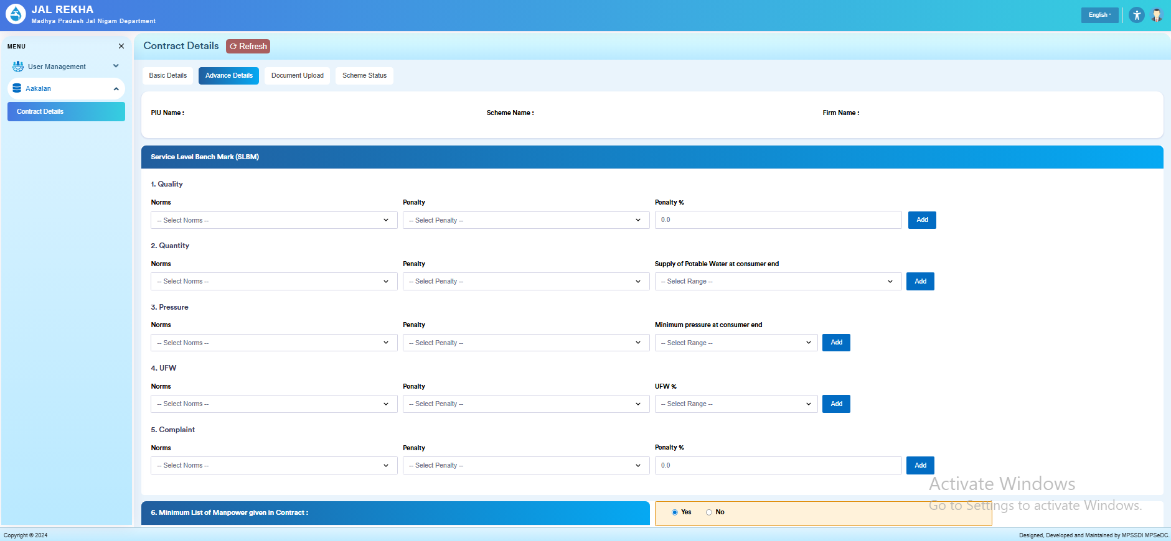
O&M Billing (GIS-based Operation and Maintenance Modules)
GM Login – Basic Details & Advance Details
Contract Details – Basic Details page for the GM in the O&M Billing module, where scheme‑level contract metadata is set up before any RA bills are generated.
GM Advance Details screen configures SLBM norms and corresponding penalties for quality, quantity, pressure, UFW, and complaints that will later drive automatic deductions in O&M billing.

Slide 10
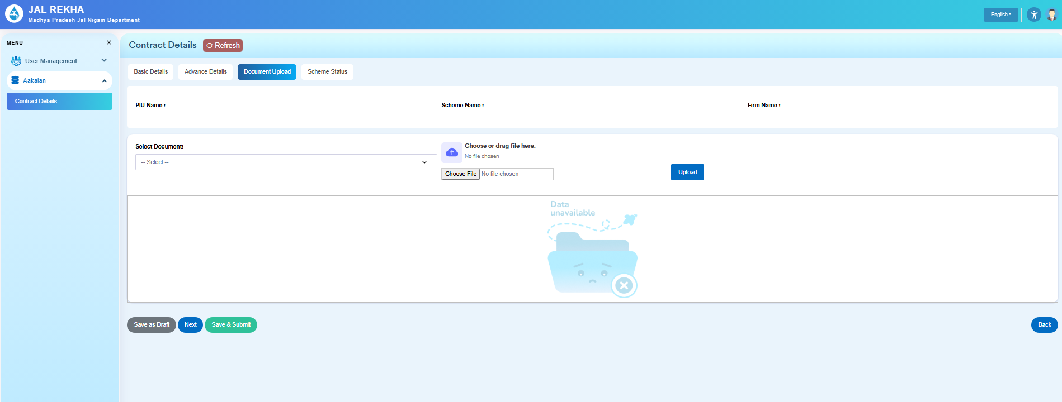
O&M Billing (GIS-based Operation and Maintenance Modules)

Slide 11
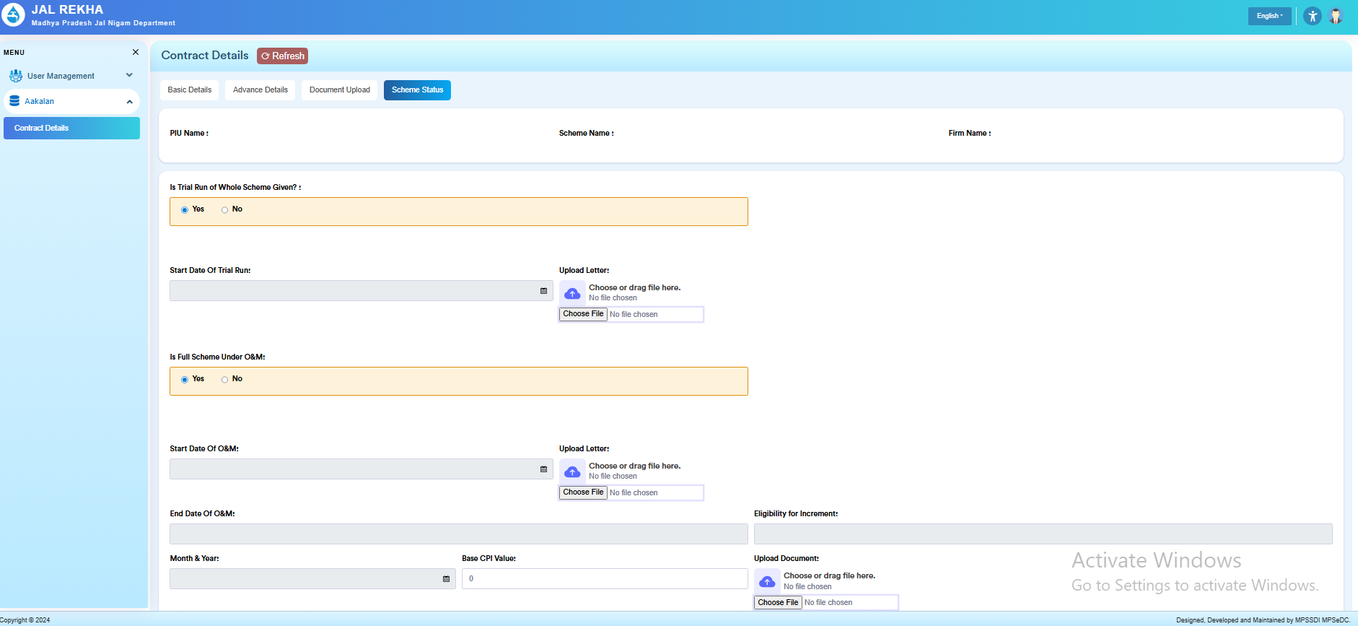
O&M Billing (GIS-based Operation and Maintenance Modules)
GM Login – Scheme Status
Scheme Status page lets the GM record whether the scheme has completed trial run and entered full O&M, with corresponding start/end dates, base CPI value and supporting letters that control eligibility for O&M increment calculations.

Slide 12
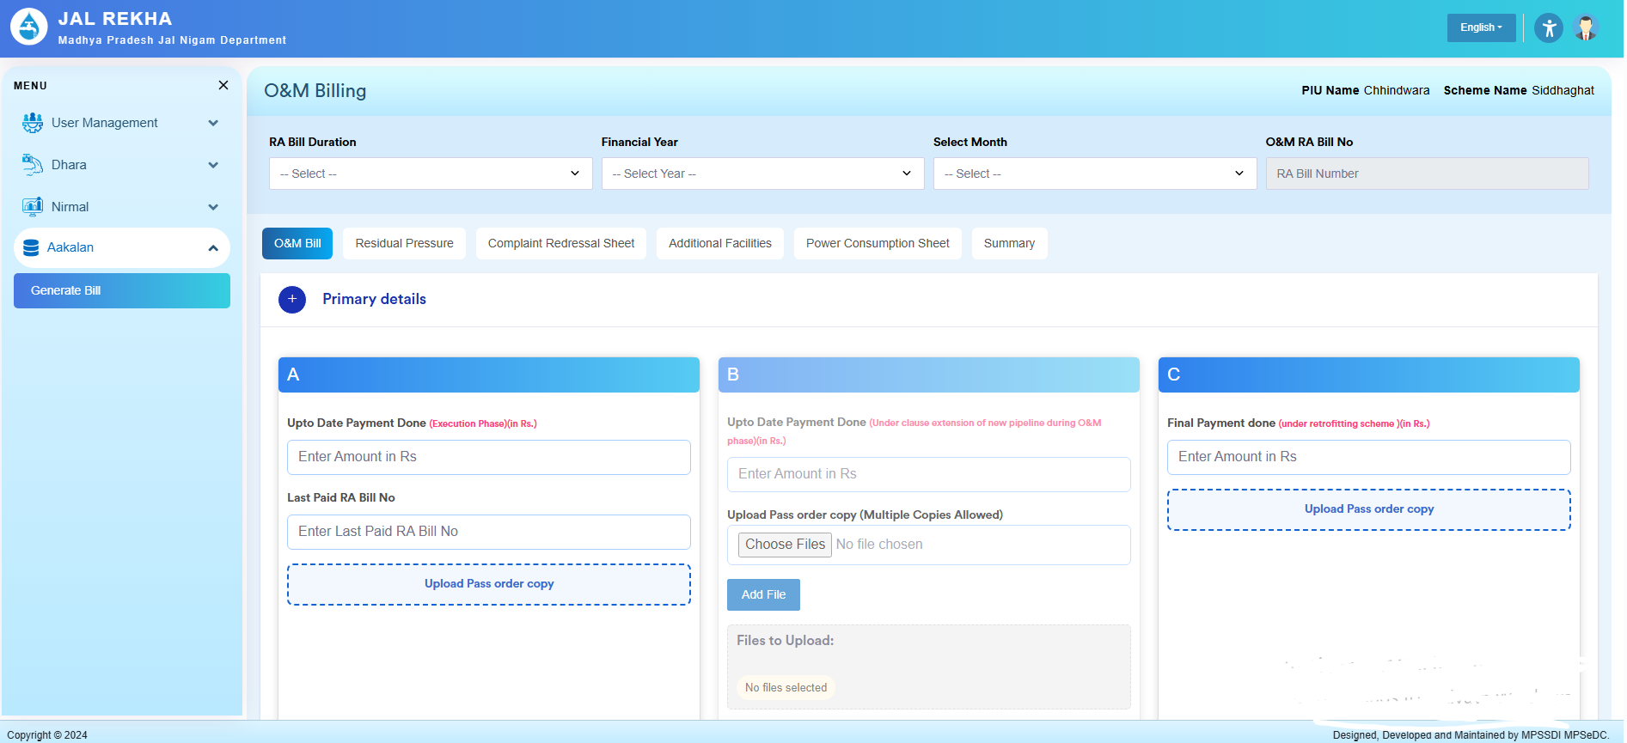
O&M Billing (GIS-based Operation and Maintenance Modules)
O&M Billing Contractor Login
O&M RA bill entry - At the top, the contractor selects RA Bill Duration, Financial Year, and Month; the system also shows PIU Name, Scheme Name, and the selected O&M RA Bill Number.​
These selections decide which running‑account bill instance they are updating so that calculations and approvals link to the correct scheme and period.
At the top, the contractor selects RA Bill Duration, Financial Year, and Month; the system also shows PIU Name, Scheme Name, and the selected O&M RA Bill Number.​
These selections decide which running‑account bill instance they are updating so that calculations and approvals link to the correct scheme and period.

Slide 13
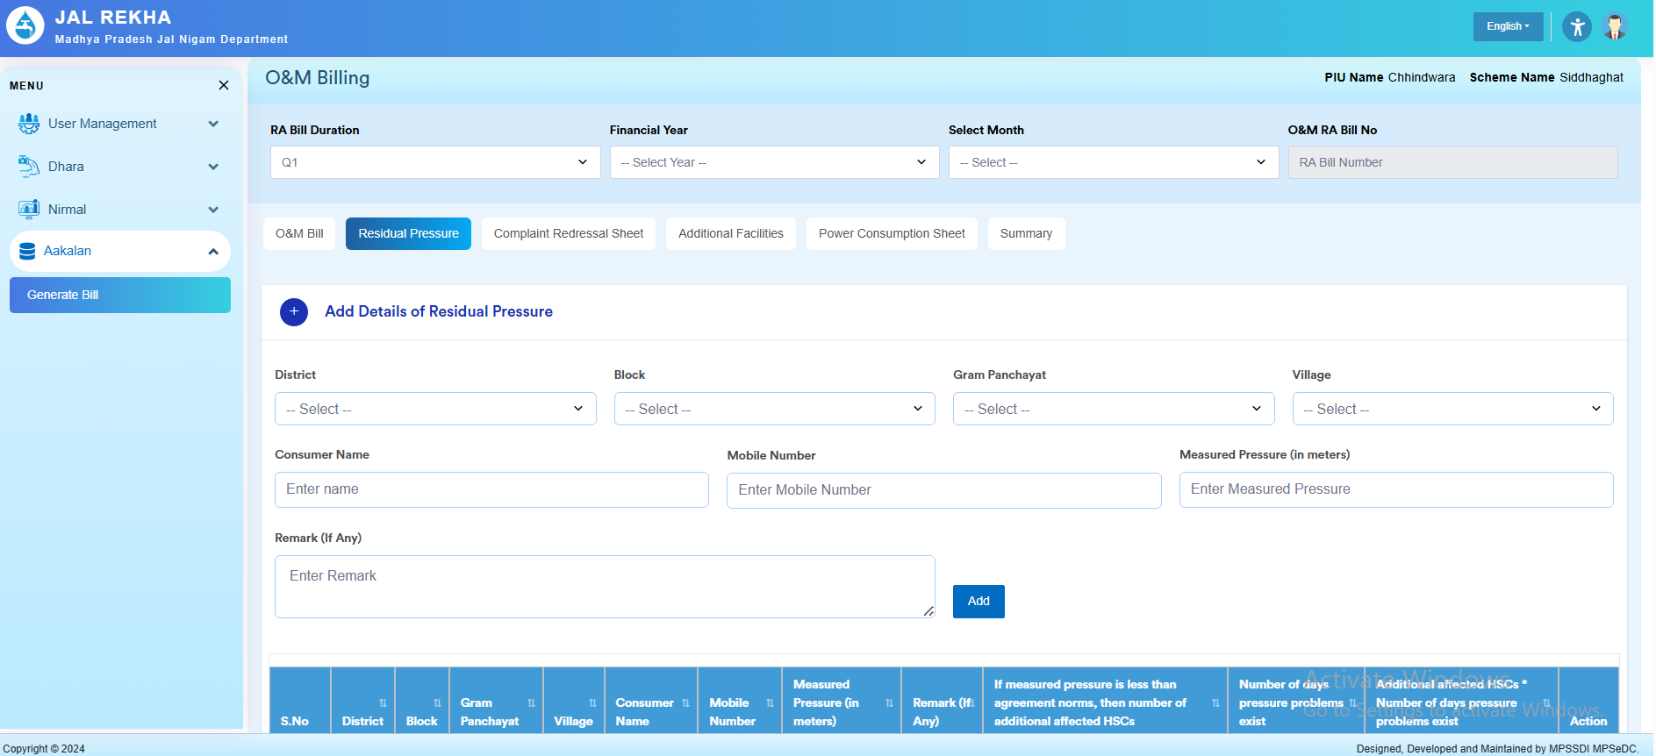
O&M Billing (GIS-based Operation and Maintenance Modules)
O&M Billing Contractor Login
Below the header there are multiple tabs: O&M Bill, Residual Pressure, Complaint Redressal Sheet, Additional Facilities, Power Consumption Sheet, Summary.​
The current slide shows the O&M Bill tab, which captures high‑level payment amounts and pass‑order copies; other tabs capture technical performance and will later influence deductions and final payable amount.

Slide 14
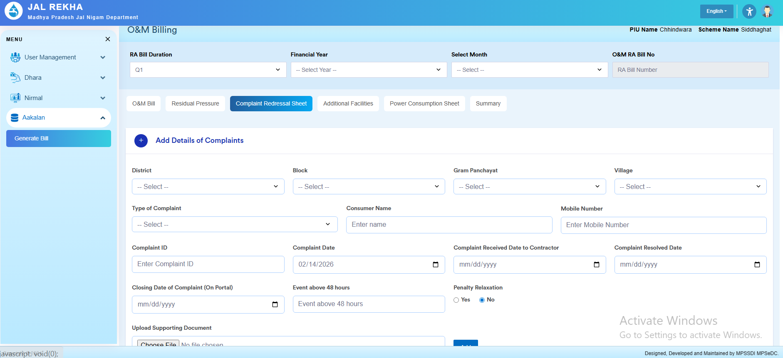
O&M Billing (GIS-based Operation and Maintenance Modules)
Residual pressure tab
In the O&M Billing workflow, the Residual Pressure tab is where the contractor records pressure readings at service points to show that minimum pressure norms are met.​
These entries are linked with SLBM “Pressure” norms; out‑of‑range values can attract penalties that the system considers when computing net payable O&M bill.
Complaint Redressal Sheet – complaint details
The form section “Add Details of Complaints” lets the contractor log each consumer complaint closed during the period, with fields for District, Block, Gram Panchayat and Village, ensuring proper location tagging.​
For each complaint they select Type of Complaint, and capture consumer details: Consumer Name and Mobile Number.

Slide 15
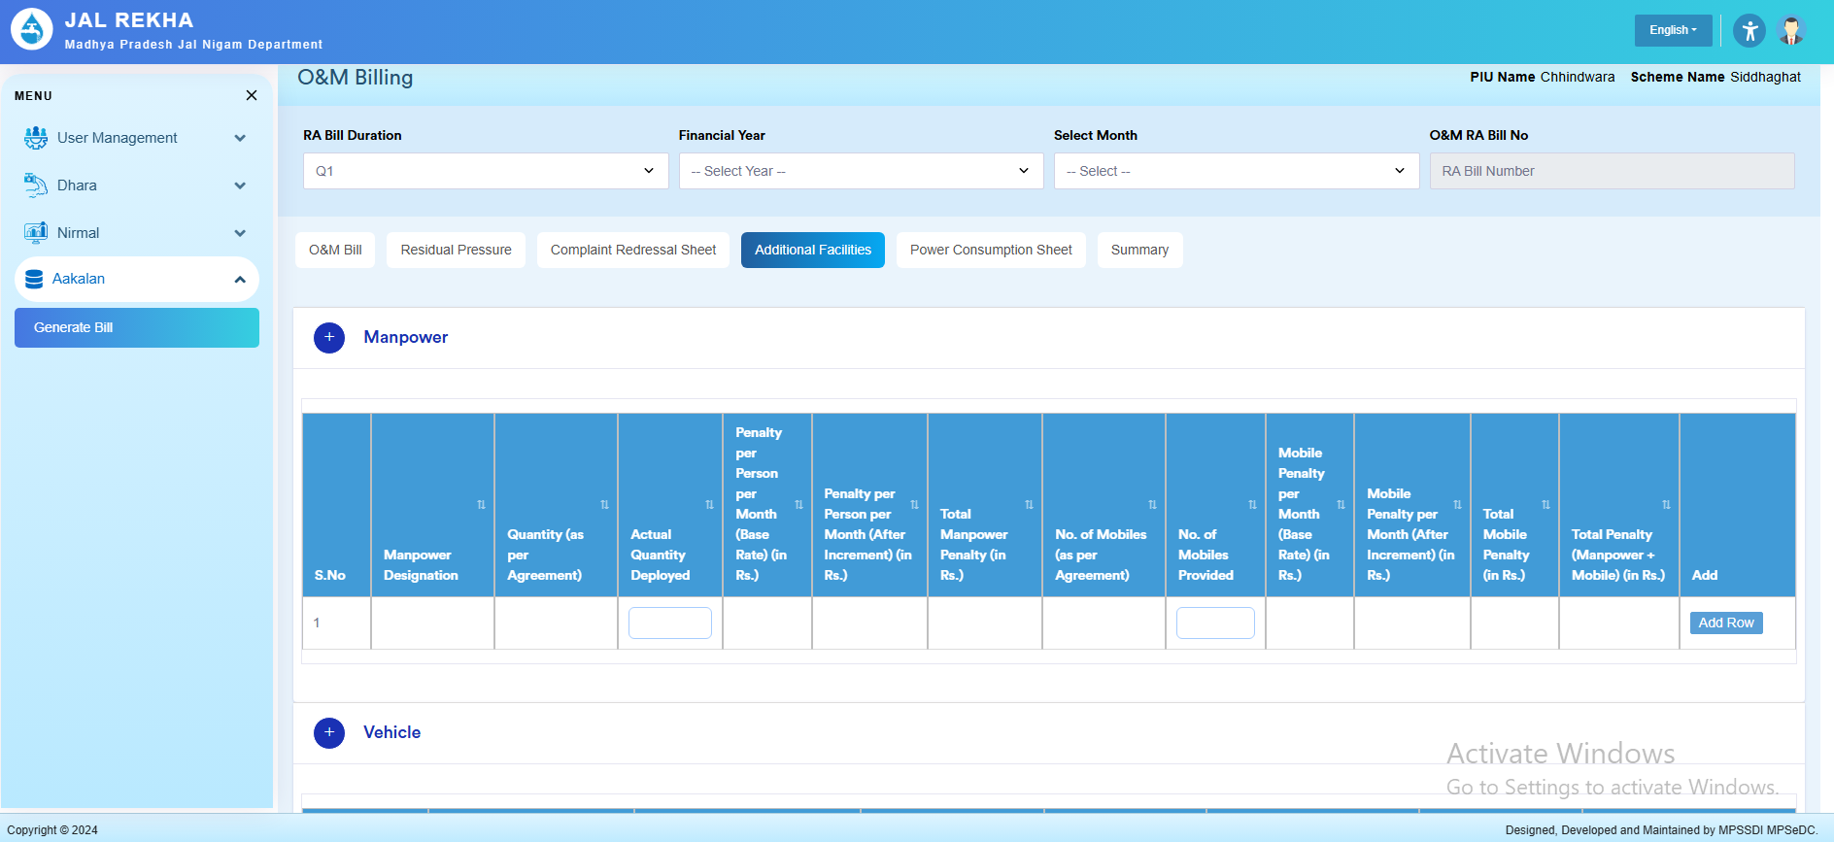
O&M Billing (GIS-based Operation and Maintenance Modules)
Additional Facilities tab
O&M Billing, where the contractor records manpower and vehicle provisioning against contract norms so that manpower‑ and mobile‑related penalties can be computed for the RA bill.

Slide 16
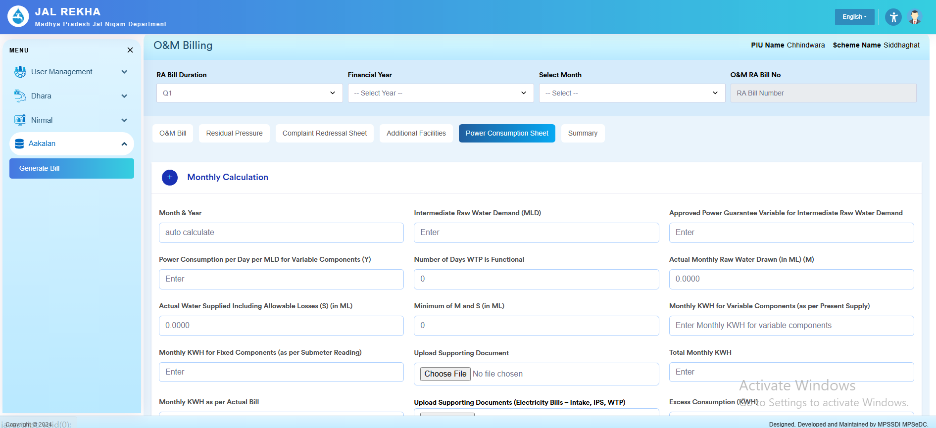
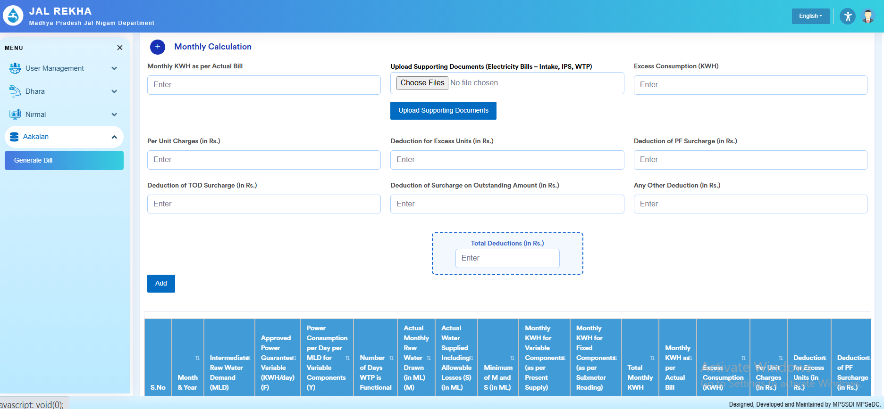
O&M Billing (GIS-based Operation and Maintenance Modules)

Slide 17
O&M Billing (GIS-based Operation and Maintenance Modules)
Power Consumption Sheet tab
The contractor captures electricity‑related data for WTP/Intake/IPS so that power‑use efficiency and excess‑consumption deductions can be computed for the RA bill.
Monthly calculation inputs
The header again fixes RA Bill Duration, Financial Year, Month and O&M RA Bill Number for which these power figures apply.​
In “Monthly Calculation”, the contractor enters Month & Year (auto‑calculated), Intermediate Raw Water Demand (MLD), Approved Power Guarantee Variable for Intermediate Raw Water Demand, and Actual Monthly Raw Water Drawn (ML).​
Variable and fixed power parameters
The form takes Power Consumption per Day per MLD for Variable Components (Y) and Number of Days WTP is Functional, which drive the expected variable KWH.​
It also records Actual Water Supplied including Allowable Losses (S) and the Minimum of M and S, then asks for Monthly KWH for Variable Components (as per Present Supply) and Monthly KWH for Fixed Components (as per sub‑meter reading).​
Supporting documents and total KWH
For fixed‑component KWH, the contractor uploads a supporting document (e.g., sub‑meter reading sheet).​
Fields like Total Monthly KWH, Monthly KWH as per Actual Bill, and Upload Supporting Documents (Electricity Bills – Intake, IPS, WTP) link the numeric entries with scanned electricity bills for audit.
Excess consumption and deductions
The lower part captures Excess Consumption (KWH) derived from comparison of approved and actual KWH.​
The contractor then enters monetary deductions: Per Unit Charges, Deduction for Excess Units, Deduction of PF Surcharge, Deduction of TOD Surcharge, Deduction of Surcharge on Outstanding Amount, and Any Other Deduction, all in rupees.​
Roll‑up into bill
A “Total Deductions (in Rs.)” box summarizes all power‑related deductions for that month, with an Add button to append the record to the tabular list below (showing month‑wise KWH and deduction columns).​
These totals feed into the O&M RA bill’s penalty section, ensuring that high power consumption beyond guarantees directly reduces the contractor’s payable amount.

Slide 18
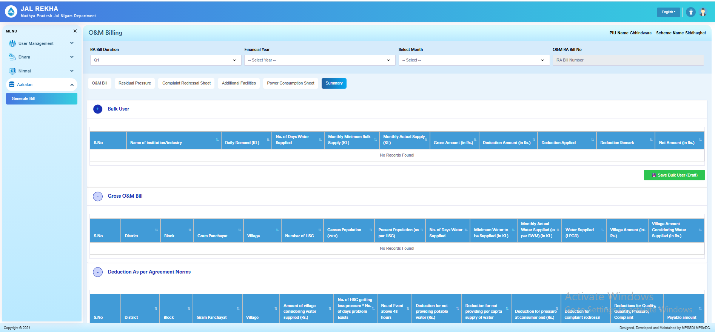
O&M Billing (GIS-based Operation and Maintenance Modules)
O&M Billing Contractor Login - Summary of Bill
Summary tab of O&M Billing, where the contractor sees and records the consolidated impact of bulk users, service levels and deductions to arrive at the payable RA bill amount.

Slide 19
O&M Billing (GIS-based Operation and Maintenance Modules)
O&M Billing Contractor Login - Summary of Bill
Bulk User section
The first panel “Bulk User” summarises supply and billing for institutional/industrial bulk consumers connected to the scheme.​
Columns include S.No, Name of institution/industry, Daily Demand (KL), No. of Days Water Supplied, Monthly Minimum Bulk Supply (KL), Monthly Actual Supply (KL), Gross Amount (Rs.), Deduction Amount (Rs.), Deduction Applied, Deduction Remark, and Net Amount (Rs.).​
The “Save Bulk User (Draft)” button lets the contractor store these entries as a draft before final bill submission.​
Gross O&M Bill section
The next panel “Gross O&M Bill” aggregates scheme‑wide supply norms versus actual performance for domestic consumers.​
It captures geography (District, Block, Gram Panchayat, Village), Number of HSC, Census Population (2011), Present Population (per HSC), No. of Days Water Supplied, Minimum Water to be Supplied (KL), Monthly Actual Water Supplied (as per BWM) (KL), Water Supplied (LPCD), and computed Village Amount and Village Amount Considering Water Supplied (Rs.).
This section essentially represents the gross O&M entitlement before applying penalties for quality, quantity, pressure or complaints.
Deductions as per agreement norms
The final panel “Deduction As per Agreement Norms” holds all service‑level deductions that will reduce the gross amount to arrive at payable value.​
Columns include geography fields plus: Amount of village considering water supplied, No. of HSC getting low pressure + no. of days problem exists, No. of events above 48 hours, Deduction for not providing potable water, Deduction for not providing per‑capita supply of water, Deduction for pressure at consumer end, Deduction for complaint redressal, and a final Payable amount after these quality/quantity/pressure/complaint deductions.
How contractor uses the Summary sheet
After filling all earlier tabs (billing, residual pressure, complaints, additional facilities, power), the contractor reviews and edits these summary rows so that bulk‑user billing, gross O&M entitlement and all agreement‑based deductions are correctly reflected.
Once satisfied, they save and forward the RA bill, and this summary becomes the key reference for GM/PIU, SQC and higher‑level approvers while reviewing the contractor’s O&M payment for the period.

